Slide 1
GP HW12 (CH 14)
Solution

Slide 2
HW12-1:
A particle with mass m and velocity moves in a one-dimensional potential , where U₀ and A are positive constants and r > 0.
There is a static equilibrium point at r = r₀ for this potential. Find the equilibrium point r₀ and the potential at this point in terms of A and U₀.
Find the equation of motion for this system.
Near the equilibrium point r₀, the system can be approximated as a simple harmonic oscillator (SHO). Let r = r₀ + x, rewrite the equation of motion in part b) as function of x by using the formula
d) Find the period of this particle in terms of r₀, m, and/or U₀.
HW12-2: A uniform rod with length 2l, mass M hang from one end and the center of rod is attached with a horizontal massless spring with spring constant k (left figure shown below). This spring is initially at the equilibrium position (θ = 0). Now the rod is displaced by a small angle θ (left figure below) from the vertical position and is then released. Assume the angle θ is so small such that sinθ ~ θ, cosθ ~ 1.
Draw the free body diagram of the rod. Find the equation of the motion of the rod and its period T.
Now assume the rod is initially at equilibrium position (θ = 0). At t = 0, a bullet of mass 4M/3 strikes and becomes embedded inside the rod at position l/2 from the pivot (right figure shown below). Assume the speed of the bullet is v, Find the new period T_{N} of the motion of the rod, and find new θ (t) with initial condition given above.
Pivot
Pivot
l/2
θ
l
l

Slide 3
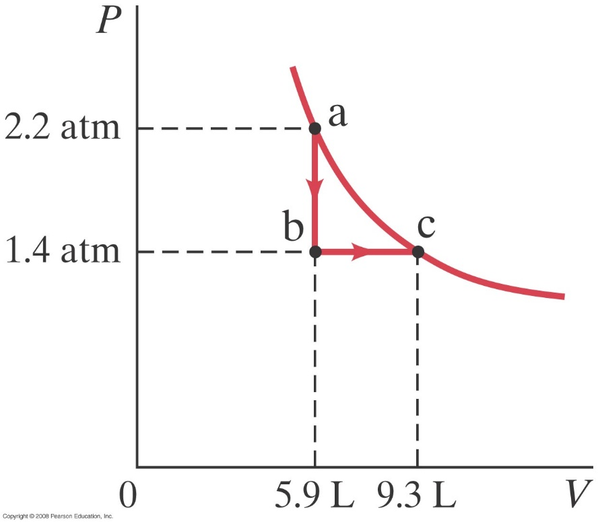
HW12-3: Problem 19-31 in Giancoli (pp. 523)
(II) Consider the following two-step process. Heat is allowed to flow out of an ideal gas at constant volume so that its pressure drops from 2.2 atm to 1.4 atm. Then the gas expands at constant pressure, from a volume of 5.9 L to 9.3 L, where the temperature reaches its original value. See Fig. 19–30. Calculate
the total work done by the gas in the process
the change in internal energy of the gas in the process
the total heat flow into or out of the gas.

Slide 4
HW12-1:
A particle with mass m and velocity moves in a one-dimensional potential , where U₀ and A are positive constants and r > 0.
There is a static equilibrium point at r = r₀ for this potential. Find the equilibrium point r₀ and the potential at this point in terms of A and U₀.
Find the equation of motion for this system.
Near the equilibrium point r₀, the system can be approximated as a simple harmonic oscillator (SHO). Let r = r₀ + x, rewrite the equation of motion in part b) as function of x by using the formula
d) Find the period of this particle in terms of r₀, m, and/or U₀.
Sol:
求極值➔一次微分=0

Slide 5
只有保守力做功➔力學能守恆
Equation of motion:
Or from F = ma →
➔

Slide 6
Equation of motion:
Equation of motion becomes:

Slide 7
HW12-2: A uniform rod with length 2l, mass M hang from one end and the center of rod is attached with a horizontal massless spring with spring constant k (left figure shown below). This spring is initially at the equilibrium position (θ = 0). Now the rod is displaced by a small angle θ (left figure below) from the vertical position and is then released. Assume the angle θ is so small such that sinθ ~ θ, cosθ ~ 1.
Draw the free body diagram of the rod. Find the equation of the motion of the rod and its period T.
Now assume the rod is initially at equilibrium position (θ = 0). At t = 0, a bullet of mass 4M/3 strikes and becomes embedded inside the rod at position l/2 from the pivot (right figure shown below). Assume the speed of the bullet is v, Find the new period T_{N} of the motion of the rod, and find new θ (t) with initial condition given above.
Sol:
a)
Pivot
solving by the conservation of the mechanical energy
θ
l

Slide 8
A bullet with mass 4M/3 embedded at l/2 the KE and PE become
(b)
Pivot
θ
l

Slide 9

HW12-3: Problem 19-31 in Giancoli (pp. 523)
(II) Consider the following two-step process. Heat is allowed to flow out of an ideal gas at constant volume so that its pressure drops from 2.2 atm to 1.4 atm. Then the gas expands at constant pressure, from a volume of 5.9 L to 9.3 L, where the temperature reaches its original value. See Fig. 19–30. Calculate
the total work done by the gas in the process
the change in internal energy of the gas in the process
the total heat flow into or out of the gas.
Sol:
(a)1st step (a→b)：無做功
2nd step (b→c)：
(b)由 可知 a 點和 c 點溫度相同，故
(c)由熱力學第一定律可知

